Slide 1


FLOWSENSE
Intelligent Traffic Command Center
A Neuro-Symbolic Approach to Proactive Traffic Management
Team Leader: Aman Yadav | Team: Rahul, Aryan Chaudhary

Slide 2
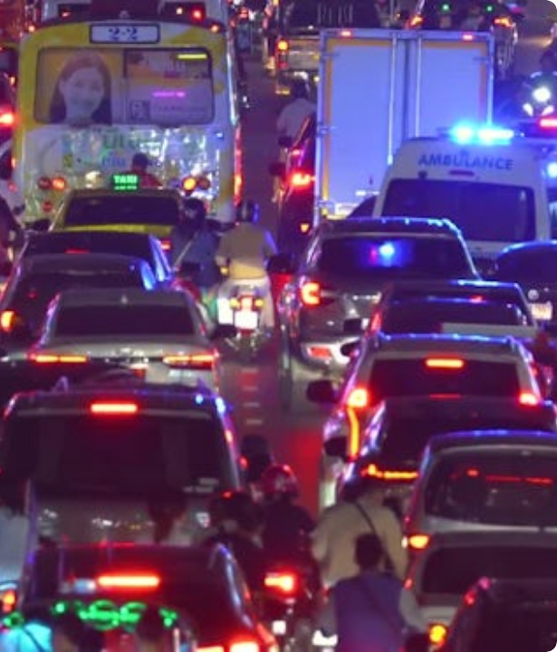
The Operational Challenge
Event-Driven Congestion
Urban traffic networks are highly sensitive to disruptions. Localized traffic breakdowns quickly cascade through the city grid.
Planned Events
Political rallies, festivals, sports events, and scheduled construction activities.
Unplanned Incidents
Sudden gatherings, heavy vehicle breakdowns, and unexpected water logging.

Slide 3





Why It's Hard Today
City traffic management is fundamentally reactive. Current systems lack predictive intelligence.
Unquantified Impact
Experience-Driven
No Post-Event Learning
Event impact is not mathematically quantified in advance. Standard systems cannot predict the cascading severity of sudden urban disruptions.
Resource deployment relies heavily on human intuition. Dispatchers are forced to guess optimal manpower and barricading needs on the fly.
Cities repeat the same mistakes. There is no automated system to learn from past event responses and codify better operational rules.

Slide 4
Problem Statement Direction
"How can historical and real-time data be used to forecast event-related traffic impact and recommend optimal manpower, barricading, and diversion plans?"

Slide 5



The FlowSense Architecture
A 4-Layer Neuro-Symbolic Hybrid AI designed to structure chaos and enforce logical rules.
Neuro Layer (NLP)
Symbolic Layer (Logic)
Structuring the Chaos.
Hard-Coded Urban Rules.
We use Machine Learning (TF-IDF Vectorization and Random Forests) to instantly read raw, unstructured dispatch text and map it to strict Urban Event Categories.
We inject deterministic city-planning rules to act as a logic filter, ensuring the AI operates strictly within established, safe operational parameters.

Slide 6


Layer 1: NLP Classification (Neuro)
Extracting root causes from raw, chaotic dispatch text.
Handling Slang & Panic: Incoming reports are unstructured. Our NLP layer cuts through the noise.
Real-Time Vectorization: Text is mathematically transformed and fed into a balanced Random Forest Classifier.
Standardized Output: Automatically maps vague reports (e.g., "crater in road") to strict categories like "Pothole".

Slide 7

Layer 2: Expert Logic Engine (Symbolic)
Overriding AI bias by hard-coding deterministic city-planning rules directly into the decision pipeline.
Preventing Hallucinations: Pure Machine Learning models can hallucinate or misinterpret edge cases. Our Symbolic layer prevents this by enforcing strict protocols.
Contextual Intelligence in Action: The logic engine ensures that a "Vehicle Breakdown" only triggers High Priority resource allocation if the NLP specifically detects a "bus" or "heavy truck". Minor car incidents are accurately downgraded.

Slide 8
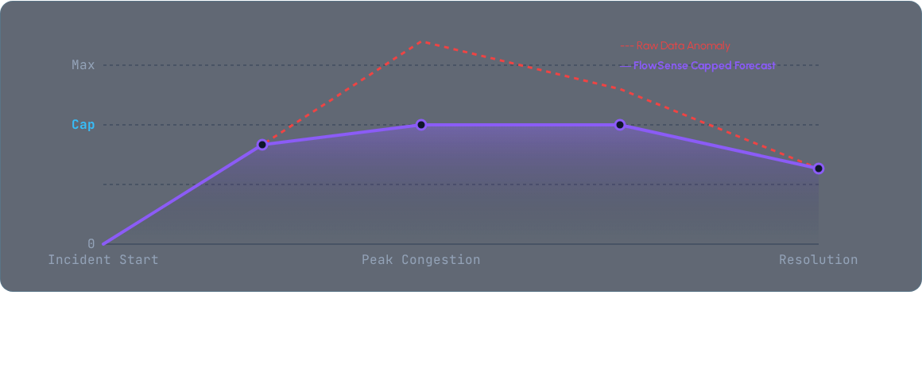
Layer 3: Impact Forecasting
Predicting clearance time using an Outlier Capping Algorithm. By capping predictions at 3x the historical median, we guarantee realistic, actionable timeframes for dispatchers during extreme anomalies.

Slide 9





Layer 4: Prescriptive Dashboard
Outputting precise, actionable tactical plans for dispatchers in milliseconds.
Manpower Limits
Barricading Hardware
Upstream Diversion
Recommends optimal officer deployment counts (e.g., "6-10 Officers") based on the hybrid impact score, preventing resource overallocation.
Prescribes exact hardware needs, intelligently shifting directives from "Light Cones" to "Heavy Reflective Barricades".
Calculates if immediate route diversion is required to isolate the event and preserve surrounding corridor traffic flow.

Slide 10

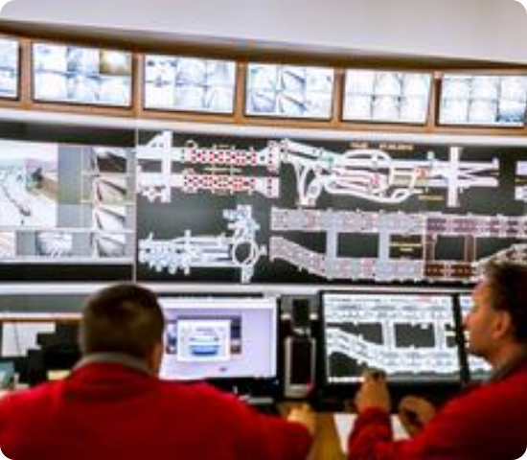


The Data Engine
Grounded in Reality.
FlowSense is not built on theoretical models. The engine is trained directly on the provided Astram Dataset.
8,173
Traffic Events Analyzed
54
Police Stations Covered

Slide 11


Thank You
The Intelligence Behind the Flow.
Aman Yadav
Rahul
Aryan Chaudhary

